Slide 1

Welcome To OUR Presentation
Course Title: Computer Fundamentals
Course Teacher: Mr. Dewan Mamun Raza, Senior Lecturer
Department of CSE, Daffodil International University
Presentation On: Cryptography

Slide 2




OUR TEAM
UMME ARIFA ZAMAN NIRJHOR​​
SUPAN ROY
Junaid Hasan
MD Saymon Shojib
232-15-695
232-15-716
232-15-735
232-15-717

Slide 3

Cryptography
3

Slide 4
Table Of Contents
SL. Number | Area Covered
1 | What is Cryptography?
2 | History of Cryptography
3 | The Importance of Cryptography
4 | Types of Cryptographic Algorithms
5 | Cryptography Example
6 | Everyday Application of Cryptography
7 | Modern Cryptography Concerns
8 | How to Reduce the Risk of Cryptography related issue?

Slide 5

What is Cryptography ?
Cryptography is the process of hiding or coding information so that only the person a message was intended for can read it. The art of cryptography has been used to code messages for thousands of years and continues to be used in bank cards, computer passwords, and e-commerce.

Slide 6
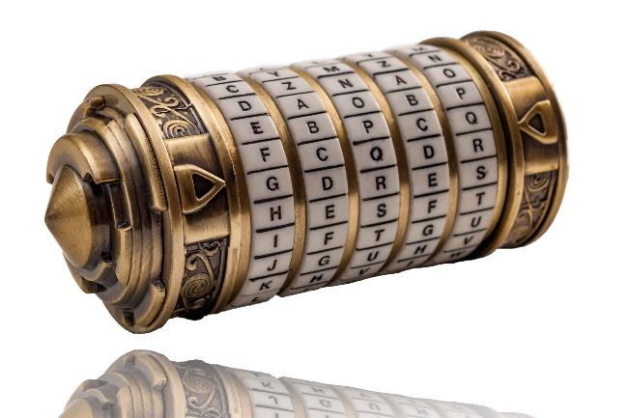
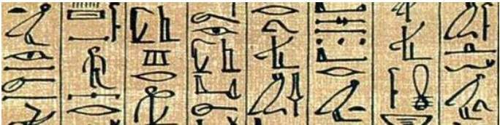
History of Cryptography
The term “Cryptography” comes from the Greek language and the word “kryptos,” which means hidden.
The study of cryptography dates back to ancient Egypt, some 4,000 years ago, and is evident in their very complex pictograms, or hieroglyphics. The very first use of modern cryptography and ciphers still used today is attributed to Julius Caesar, a Roman general and politician.
Ancient Cryptography

Slide 7
The Importance of Cryptography
Cryptography remains important to protecting data and users, ensuring confidentiality, and preventing cyber criminals from intercepting sensitive corporate information. Common uses and examples of cryptography include the following:
Privacy and Confidentiality
Integrity
Cryptography ensures confidentiality by encrypting sent messages using an algorithm with a key only known to the sender and recipient.
No one has the authority to change the message information while in storage or in transit between sender and receiver without this change being detected.
Non-Repudiation
Authentication
Both the sender and receiver are in a position of not being able to deny their intent of the information’s existence or transmission.
The senders and receivers must be able to confirm each other’s identity, as well as the origin of the encrypted message.

Slide 8
Types of Cryptographic Algorithms
1
2
3
Symmetric/Secret Key Cryptography
Asymmetric/Public Key Cryptography
Hash Function Cryptography

Slide 9
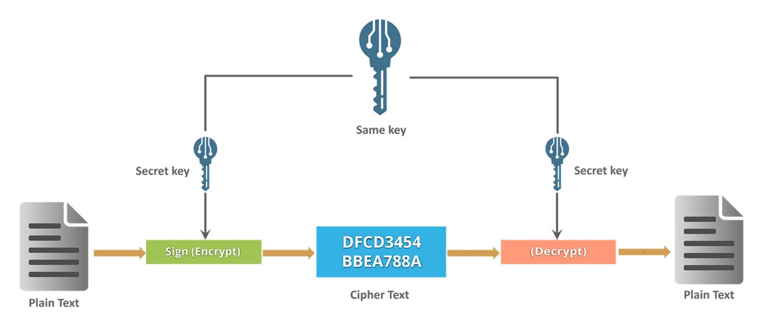
Symmetric/Secret Key Cryptography
Secret key cryptography, also known as symmetric encryption, uses a single key to encrypt and decrypt a message. The sender encrypts the plaintext message using the key and sends it to the recipient who then uses the same key to decrypt it and unlock the original plaintext message.

Slide 10
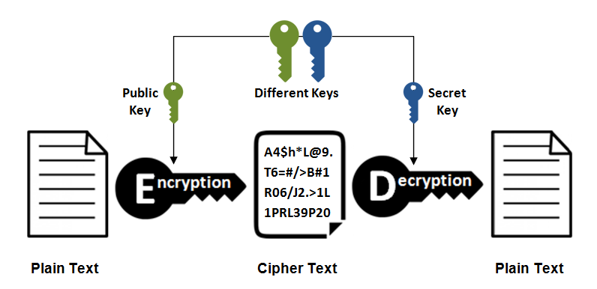
Asymmetric/public Key Cryptography
The encryption process where different keys are used for encrypting and decrypting the information. Keys are different but are mathematically related, such that retrieving the plain text by decrypting ciphertext is feasible.

Slide 11
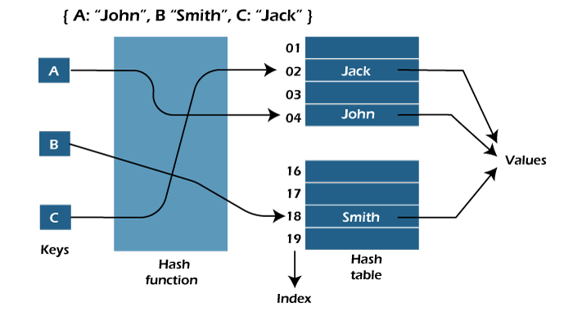
Hash Function cryptography
Public and private key cryptographic algorithms both transform messages from plaintext to secret messages, and then back to plaintext again.
On the other hand, a hash function relies on one-way algorithms. Once a plaintext has been encrypted, it remains a ciphertext, also known as hash. A hash function transforms a key or digital signature, then the hash value and signature are sent to the receiver, who uses the hash function to generate the hash value and compare it with the one they received in the message.

Slide 12
Cryptography Examples
All three cryptography types are implemented in different algorithms and techniques. Now let’s see several important cryptography examples and discuss whether they use secret key, public key, or hash value.

Slide 13

Data Encryption Standard (DES)
Data Encryption Standard (DES) was established in 1971, it was a major breakthrough in cybersecurity. It relies on symmetric encryption.

Slide 14

Advanced Encryption Standard (AES)
The Advanced Encryption Standard (AES) is the successor of DES and is considered the most secure encryption algorithm today. It’s even the federal standard, used by the U.S. government, but also by major social media platforms and corporations. The AES falls under the category of symmetric encryption, meaning it requires the same key encryption to protect communications.

Slide 15
Diffie-Hellman Key Exchange
One example of an asymmetric encryption is the Diffie-Hellman, or exponential key exchange. This is a digital encryption method that relies on numbers raised to specific powers in order to create decryption keys that were never sent directly. It is used to secure different online services.
Hashing Algorithms
Hash values and algorithms offer a wide range of functions and are used for specific purposes. Password verification, proof-of-work in blockchain technology, and file or data identification are just some of the many ways hash algorithms are used.

Slide 16
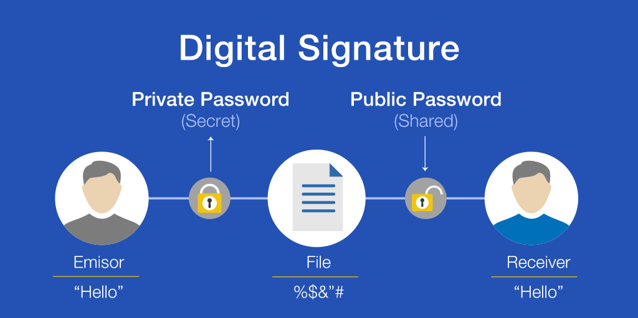
Everyday Application of Cryptography
1. Digital Signatures
When it comes to public key cryptography, digital signature authentication is essential. Authentication refers to any process that verifies specific information. If you want to verify the identity of a sender or the origin of a document, or when it was signed, cryptography uses a digital signature as a means to check the information.

Slide 17
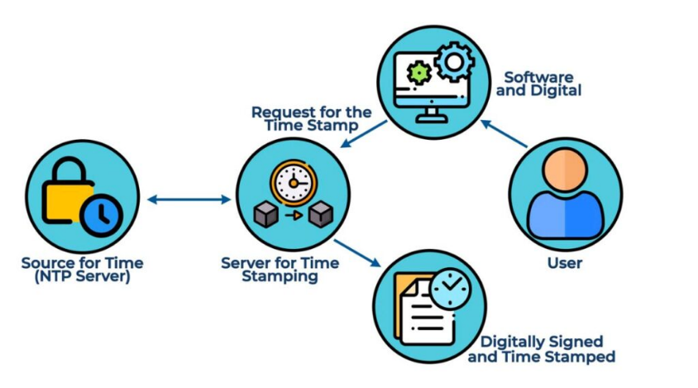
Everyday Application of Cryptography
2. Time Stamping
A digital time stamp tells us that a certain digital document was created or delivered at a specific time. The cryptographic system used for time stamping is called a blind signature scheme, which allows senders to transmit a message to a recipient via a third party without revealing any part of the message to them.

Slide 18
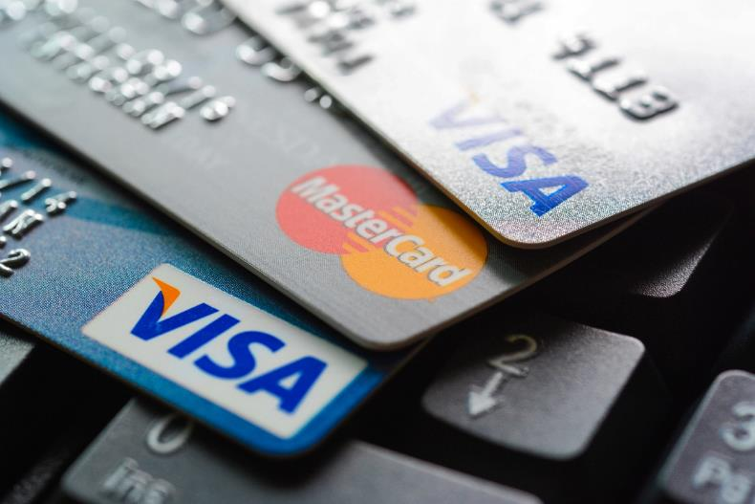
Everyday Application of Cryptography
3. Electronic Money
Digital money, or electronic cash, is a constantly evolving concept. Essentially, it involves financial transactions done electronically from one party to another.
Cryptography is applied in both debit and credit card transactions and digital wallets. And it is required for anonymous and identified transactions.

Slide 19

Everyday Application of Cryptography
4. Cryptocurrency
The application of cryptography allows blockchains to maintain security, which is at the core of cryptocurrency systems. In fact, it was the cryptography message board that prompted the creation of Bitcoin in 2009.

Slide 20
Modern Cryptography Concerns
A modern cryptographic algorithm is considered unbreakable, for the most part at least. But there are some concerns :
Weak Key
Key Non-Rotation
Incorrect or Reused Key
Inadequate Key Storage
Inadequate Key Protection
Insider Threats

Slide 21
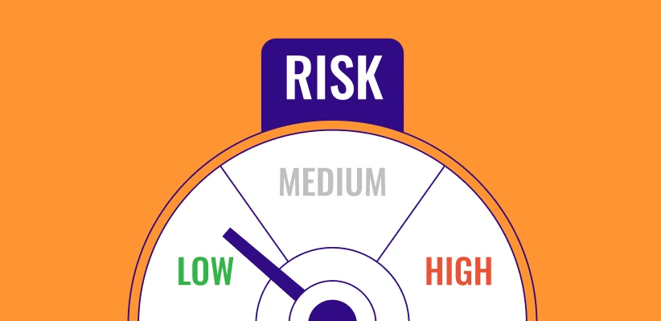
How to Reduce the Risk of Cryptography-Related Issues?
Strong key generation
Strict policy-based controls
Secure key destruction
Strong user authentication
Secure workflow management
Audits and usage logging

Slide 22
Thank you

